Slide 1
Key logger project
Presented By:
V.SRIRAM
ANJALAI AMMAL MAHALINGAM ENGINEERING COLLEGE.
B.Tech - INFORMATION TECHNOLOGY.

Slide 2
Outline
Problem Statement (Should not include solution)
Proposed System/Solution
System Development Approach (Technology Used)
Algorithm & Deployment
Result (Output Image)
Conclusion
Future Scope
References

Slide 3
Problem Statement
The key logger detection and prevention problem entail developing robust mechanisms to identify and mitigate the threat posed by key logging software or hardware. This involves both proactive measures to prevent key loggers from infiltrating systems and reactive measures to detect and remove them if they are already present.

Slide 4
Proposed Solution
Detection Mechanism: Utilizing Python's libraries such as psutil for process management and os for file system operations, we will develop a script to scan system processes, files, and registry entries.
Prevention Strategies:
User Permission Controls: Utilizing Python's subprocess module, we will manage user permissions to restrict installation of unauthorized software.
Behavioral Monitoring: Employing Python's logging module, we will monitor system behaviors, detecting anomalies that may signal keylogging activities and triggering alerts for further investigation.
Real-time Monitoring: A key component of our solution is real-time monitoring of keystrokes. By interfacing with Python's keyboard library

Slide 5
System Approach
Signature-based Detection: Utilize pattern matching algorithms to scan system files, processes, and registry entries for known keylogger signatures.
Behavioral Analysis: Employ machine learning algorithms to analyze user behavior and identify deviations that may indicate the presence of a keylogger.
API Hooking: Implement API hooking techniques to intercept and analyze system calls related to keyboard input, identifying suspicious activities.
Access Controls: Enforce user permissions to restrict installation and execution of unauthorized software using system-level controls.
Software Whitelisting/Blacklisting: Maintain a database of trusted and untrusted software to prevent the execution of known keylogging applications.
Code Integrity Checks: Implement checksum verification mechanisms to ensure the integrity of system files and prevent tampering by malicious software.

Slide 6
Algorithm & Deployment
Agent-based Deployment:
Deploy lightweight agents on endpoint devices to monitor system activities and detect keylogger threats.
Centralized Management Console:
Implement a centralized management console to deploy, configure, and monitor keylogger detection agents across all endpoints.
Real-time Monitoring and Alerting:
Configure agents to monitor system activities in real-time and analyze incoming data for signs of keylogger activity.
Automated Response Actions:
Define automated response actions to mitigate detected keylogger threats, such as quarantining infected files, terminating malicious processes, or blocking network communication.
Regular Updates and Maintenance:
Maintain regular updates to the keylogger detection algorithms, signature databases, and agent software to stay ahead of evolving threats.

Slide 7

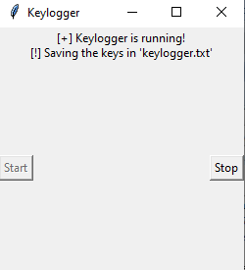
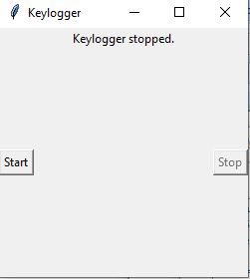
Result
The keylogger runs and save all key strokes to c:\output.txt
KEYLOGGER
Start:
Running:
Stop:

Slide 8
Conclusion
In summary, the threat of keyloggers poses a significant risk to cybersecurity, potentially compromising sensitive information through covert keystroke monitoring. Effective detection, prevention, and user education are essential in mitigating this threat. By employing sophisticated algorithms, proactive deployment strategies, and user awareness initiatives, organizations can bolster their defenses against keylogger attacks. Prioritizing these measures is crucial for safeguarding digital assets, preserving privacy, and maintaining trust in an increasingly interconnected environment.

Slide 9
Future scope
Enhanced AI algorithms for more accurate detection.
Integration with blockchain technology for immutable logging.
Development of hardware-based prevention mechanisms.
Implementation of biometric authentication to supplement keystroke analysis.
Expansion of keylogger detection to IoT and mobile devices.
Collaboration with cybersecurity firms for threat intelligence sharing.

Slide 10
References
Title: "Keylogger Threats:
Detection and Prevention" Authors: [Your Name]
Publication Date: [Publication Date]
Publisher: [Publisher Name]
DOI/URL: [DOI or URL if available]

Slide 11
THANK YOU

